Slide 1
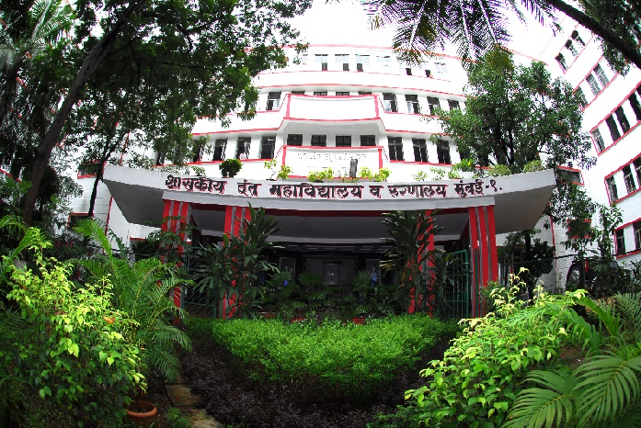
THE FOUNDATION OF COMMUNICATION
GOVERNMENT DENTAL COLLEGE & HOSPITAL, MUMBAI
DEPARTMENT OF PEDIATRIC AND PREVENTIVE DENTISTRY
PRESENTED BY: DR. DIMPLE PADAWE

Slide 2
CONTENT
Importance of communication
The Communication Process
Verbal Communication
Nonverbal communciation
Listening Skills
Empathy and Emotional Intelligence
Barriers to Effective Communication
Strategies for Improving Communication
Applying Communication skills in Practice
Conclusion

Slide 3
THE IMPORTANCE OF COMMUNICATION
Building Relationships
Sharing Information
Communication allows us to share knowledge, ideas, and experiences, fostering growth and progress.
Strong communication is the cornerstone of healthy relationships, whether personal or professional.
Solving Problems
Effective communication is vital for collaborating, resolving conflicts, and finding solutions.

Slide 4
THE COMMUNICATION PROCESS
1
Sender
The sender encodes their message and transmits it to the receiver.
2
Message
The message can be verbal, nonverbal, or a combination of both.
3
Receiver
The receiver decodes the message and interprets its meaning.
4
Feedback
The receiver provides feedback to the sender, ensuring understanding and closing the loop.

Slide 5
VERBAL COMMUNICATION
Clear and Concise
Active Listening
Respectful Tone
Use precise language and avoid jargon or ambiguity.
Pay attention to the speaker and ask clarifying questions.

Slide 6
NONVERBAL COMMUNICATION
Facial Expressions
Body Language
Conveying emotions through facial cues like smiles, frowns, or raised eyebrows.
Nonverbal cues like posture, gestures, and proximity can enhance or contradict verbal messages.
Eye Contact
Maintaining eye contact shows engagement and respect.

Slide 7
LISTENING SKILLS
Active Listening
Engage with the speaker by paraphrasing, asking questions, and providing feedback.
Empathetic Listening
Try to understand the speaker's perspective and emotions.
Non-Judgmental Listening
Listen without interrupting or passing judgment on the speaker's ideas.

Slide 8
Adapting to Your Audience
Self-Awareness
Understanding your own emotions and how they influence your communication.
1
Empathy
2
The ability to understand and share the feelings of others.
Emotional Regulation
3
Managing your emotions effectively to communicate constructively.

Slide 9
BARRIERS TO EFFECTIVE COMMUNICATION
Language Barriers
Cultural Differences
Differences in language or dialects can hinder understanding.
Cultural norms and values can influence communication styles.
Physical Distractions
Psychological Factors
Noise, interruptions, or uncomfortable environments can disrupt communication.
Stress, anxiety, or biases can distort communication.

Slide 10
STRATEGIES FOR IMPROVING COMMUNICATION
Active Listening
1
Pay attention to the speaker and ask clarifying questions.
Clear and Concise Language
2
Use precise language and avoid jargon or ambiguity.
Nonverbal Communication
3
Be mindful of your body language and facial expressions.
Feedback
4
Provide feedback to ensure understanding and close the loop.

Slide 11
APPLYING COMMUNICATION SKILLS IN PRACTICE
1
2
Active Listening
Clear Communication
Engage with your colleagues and actively listen to their ideas.
Express your ideas concisely and respectfully, ensuring clarity.
3
4
Conflict Resolution
Empathy
Approach conflicts constructively, seeking to understand and resolve issues.
Put yourself in the shoes of others to understand their perspectives.

Slide 12
CONCLUSION
Effective communication is the cornerstone of personal and professional success.
Understanding its foundations—such as clarity, active listening, empathy, and feedback—enables us to connect, collaborate, and convey ideas effectively.
Mastery of these skills leads to stronger relationships, better problem-solving, and a more cohesive exchange of ideas in any context

Slide 13
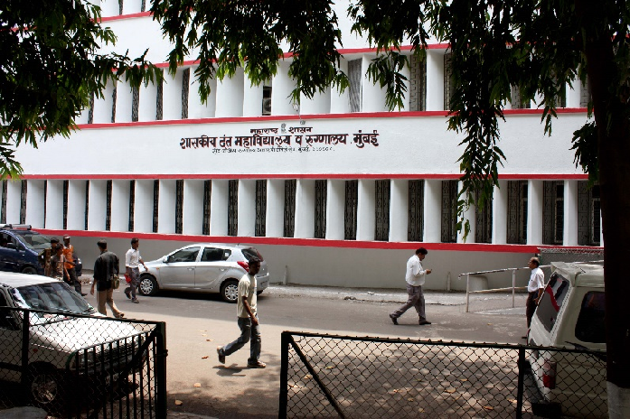
THANK YOU
deangdch_Mumbai@yahoo.com
http://www.gdchmumbai.org

