Slide 1
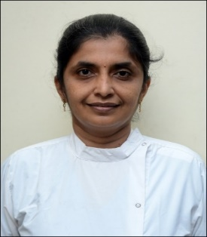
PUBLIC SPEAKING
GOVERNMENT DENTAL COLLEGE & HOSPITAL, MUMBAI
DEPARTMENT OF PEDIATRIC AND PREVENTIVE DENTISTRY
PRESENTED BY: DR.MEDHA H TANNA

Slide 2
CONTENT
Introduction
The Fear of Public Speaking & Key Elements of Public Speaking
Preparing Your Speech & Effective Use of Language
Non-Verbal Communication & Voice Control
Using Visual Aids & Practicing Your Speech
Conclusion
Quiz

Slide 3
INTRODUCTION
Why Public Speaking Matters?
Builds confidence and leadership.
Enhances professional and personal communication.
Engages and influences audiences.

Slide 4
The Fear of Public Speaking
Common Fears:
Nervousness, forgetting lines, judgment.
Statistic: 75% of people experience fear of speaking in public.
• Overcoming fear starts with preparation and practice.

Slide 5
Key Elements of Public Speaking
Content: What you say.
Delivery: How you say it.
Audience: Who you are speaking to.
Purpose: Why you are speaking.

Slide 6
Preparing Your Speech
Understand Your Purpose: Inform, persuade, entertain.
Know Your Audience: Tailor the message to their needs and interests.
Research: Back up your points with data and examples.

Slide 7
Effective Use of Language
Clarity: Simple, clear, and concise.
Vivid Imagery: Use metaphors, analogies, and vivid descriptions.
Tone & Pace: Vary your tone, speed, and volume for emphasis.

Slide 8
Non-Verbal Communication
Body Language: Eye contact, gestures, posture.
Facial Expressions: Match emotions with words.
Movement: Use the stage or space effectively.

Slide 9
Voice Control
Volume: Speak loudly enough to be heard by everyone.
Pitch: Avoid monotony; vary your pitch to add interest.
Pacing: Don't rush—give time for the audience to absorb the message.

Slide 10
Using Visual Aids
Slides: Keep slides simple (avoid too much text).
Props: Use relevant props to support your message.
Charts/Graphs: Visual representations of data can be effective

Slide 11
Practicing Your Speech
Rehearse: Practice in front of a mirror or with a friend.
Record Yourself: Helps identify areas for improvement.
Adjust for Timing: Ensure your speech fits within the allotted time.

Slide 12
CONCLUSION
Recap: Public speaking is a skill that improves with practice.
Key Takeaway: Confidence, preparation, and engagement are the keys to success.
Final Quote: “The only way to get better at public speaking is to speak publicly.”
Thank you for your attention.

Slide 13
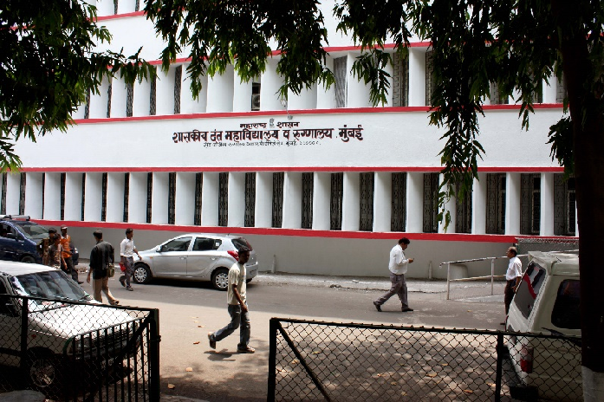
THANK YOU
deangdch_Mumbai@yahoo.com
http://www.gdchmumbai.org

