Slide 1
EFFECTIVE USE OF LANGUAGE
GOVERNMENT DENTAL COLLEGE & HOSPITAL, MUMBAI
DEPARTMENT OF PEDIATRIC AND PREVENTIVE DENTISTRY
PRESENTED BY: DR MRUNAL KARANDE

Slide 2
CONTENT
Introduction
Key elements of effective language
Techniques for effective language
Non-verbal communications
Barriers to effective use of language
Real world applications
Tips for mastery
Conclusion
Quiz
Concise, not verbose
Familiar, not obscure
Precise and clear, not in accurate or ambiguous
Constructive, not destructive
Appropriately format
Conclusion
Quiz

Slide 3
INTRODUCTION
Language is one of the most powerful tools humans possess.
It enables us to express ideas, share knowledge, and connect with others.
The effective use of language goes beyond simply speaking or writing; it involves communicating in a way that is clear, purposeful, and impactful.

Slide 4
KEY ELEMENTS OF EFFECTIVE LANGUAGE
Clarity
Use simple, direct language.
Avoid jargon unless necessary.
Conciseness
Be brief but comprehensive.
Eliminate unnecessary words.
Tone and Style
Match the tone to the audience and context.
Formal for business; conversational for casual contexts.
Adaptability
Tailor language to different audiences and situations.
Consider cultural and linguistic diversity.

Slide 5
TECHNIQUES FOR EFFECTIVE LANGUAGE
Know Your Audience
Understand their needs, background, and expectations.
Organize Ideas Logically
Follow a clear structure: introduction, main points, conclusion.
Choose Words Wisely
Go for precise and powerful words.
Engage with Rhetorical Tools
Use metaphors, anecdotes, and questions to captivate.

Slide 6
ROLE OF EMOTIONAL INTELLIGENCE IN LANGUAGE USE
Key Points:
Recognize and manage emotions to communicate effectively.
Use empathetic language to build trust and rapport.
Examples:
Using reassuring words during conflicts.
Offering constructive feedback with sensitivity.

Slide 7
LANGUAGE FOR CONFLICT RESOLUTION
The Role of Language in Defusing Tension:
Use neutral, non-confrontational language.
Reflective listening to show understanding.
Phrases for Resolution:
“I see your perspective.”
“Let’s work together to find a solution.”

Slide 8
CULTURAL SENSITIVITY IN LANGUAGE
Why It Matters:
Diverse audiences have different linguistic norms and cultural expectations.
Best Practices:
Avoid idioms or phrases that may not translate well.
Learn about your audience’s cultural background.

Slide 9
NON-VERBAL COMMUNICATIONS
Body Language
Maintain appropriate eye contact and gestures.
Tone of Voice
Use pitch, pace, and volume to reinforce meaning.
Visual Aids
Enhance understanding with diagrams, charts, or images.

Slide 10
BARRIERS TO EFFECTIVE USE OF LANGUAGE
Ambiguity
Avoid vague or unclear statements.
Overuse of Jargon
Simplify technical language for broader understanding.
Cultural Insensitivity
Be mindful of cultural nuances and preferences.

Slide 11
REAL WORLD APPLICATIONS
Professional Settings
Writing emails, delivering presentations, negotiating.
Interpersonal Communication
Resolving conflicts, building relationships, active listening.
Creative Writing
Blogs, marketing content, speeches

Slide 12
CONCLUSION
In today’s fast-paced world, the power of effective language cannot be underestimated.
By honing your skills, you not only enhance your ability to connect with others but also unlock opportunities to lead, inspire, and influence.
Remember, the way you communicate reflects not just your thoughts but also your values and intentions. Make every word count!

Slide 13
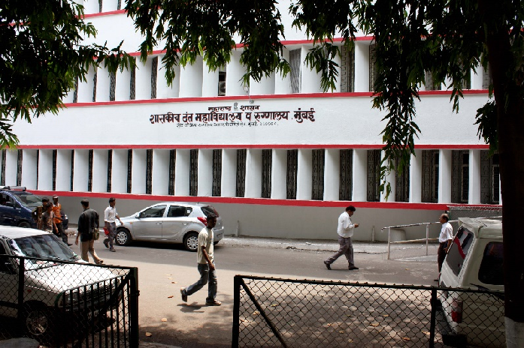
THANK YOU
deangdch_Mumbai@yahoo.com
http://www.gdchmumbai.org

