Slide 1
COMMUNICATION IN LEADERSHIP
GOVERNMENT DENTAL COLLEGE & HOSPITAL, MUMBAI
DEPARTMENT OF PEDIATRIC AND PREVENTIVE DENTISTRY
PRESENTED BY: DR.PRANJAL CHAVAN

Slide 2
CONTENT
Introduction
Communication meaning
Leadership meaning
Types of leaders
Communication process
Barrier to communication
Open communication
Conclusion
Quiz

Slide 3
INTRODUCTION
Effective communication is a cornerstone of strong leadership.
In any organization, the ability to convey ideas, expectations, and vision plays a pivotal role in shaping outcomes and fostering a collaborative culture.
Clear, transparent, and empathetic communication can inspire trust, align goals, and drive performance, while poor communication can lead to confusion, disengagement, and missed opportunities. As leaders navigate complex environments, the capacity to listen, adapt messages to diverse audiences, and engage in open dialogue becomes essential.

Slide 4
COMMUNICATION MEANING
A process by which information and understanding are transferred between a sender and a receiver.
Communication is the exchange and flow of information and ideas from one person to another; it involves a sender transmitting an idea, information, or feeling to a receiver. Studying the communication process is important because you coach, coordinate, counsel, evaluate, and supervise throughout this process. It is the chain of understanding that integrates the members of an organization from top to bottom, bottom to top, and side to side.

Slide 5
LEADERSHIP MEANING
Leadership is a process by which an executive can direct, guide and influence the behavior and work of others towards accomplishment of specific goals in a given situation.
Leadership is the potential to influence behaviour of others.
Leaders are required to develop future visions, and to motivate the organizational members to want to achieve the visions.
According to Keith Davis, "Leadership is the ability to persuade others to seek defined objectives enthusiastically. It is the human factor which binds a group together and motivates it towards goals."

Slide 6
TYPES OF LEADERS
The styles of leadership range from simple definitions to complex descriptions.
These leadership styles can be classified according to the way authority is used.
It varies when the leader is able to extract work either using people's muscles or their minds.
There are four widely accepted leadership styles.
Dictatorial Style
Authoritative Style
Consultative Style
Participative Team Style

Slide 7
COMMUNICATION PROCESS
Communication That is what we try to do Speak to those near us
Thought: First, information exists in the mind of the sender.
This can be a concept, idea, information, or feelings.
Encoding: Next, a message is sent to a receiver in words or other symbols.
Decoding: Lastly, the receiver translates the words or symbols into a concept or information that he or she can understand.

Slide 8
BARRIER TO COMMUNICATION
"Nothing is so simple that it cannot be misunderstood".
Anything that prevents understanding of the message is a barrier to communication. Many physical and psychological barriers exist:
Culture, background, and bias.
Noise,Ourselves,Perception,Message,Environmental,Smothering,Stress

Slide 9
OPEN COMMUNICATION
Why open the communication channels?
An open climate is essential for cascading vision, and cascading is essential because:
Natural Law 1: You Get What You talk about A vision must have ample 'air time' in an organization. A vision must be shared and practiced by leaders at every opportunity.
Natural Law 2: The Climate of an Organization is a Reflection of the Leader A leader who doesn't embody the vision and values doesn't have an organization that does.
Natural Law 3: You Can't Walk Faster Than One Step at aTime A vision is neither understood nor accepted overnight. Communicating must be built into continuous, daily interaction so that over time followers will internalize it.

Slide 10
NON VERBAL COMMUNICATION
To deliver the full impact of a message, use nonverbal behaviors to raise the channel of interpersonal communication:
Eye contact
Facial Expressions
Gestures
Posture and body orientation
Proximity
Vocal

Slide 11
Communication: The most important key to leadership Success.
Good Leaders, Good Communicators
Prepare how you'll communicate.
Deliver the message Receive the message.
Evaluate the effectiveness of the communication afterwards
Take corrective action as necessary

Slide 12
CONCLUSION
Communication is the key.
Bottom line, clear communication is the most important key to a business leader's success.
So to grow as a leader and manager, you must learn how to be an effective, compelling communicator.
And if you want your company to succeed, you and your team have to master the art of clear communication together, as well as you and your employees can reach new levels of leadership excellence.

Slide 13
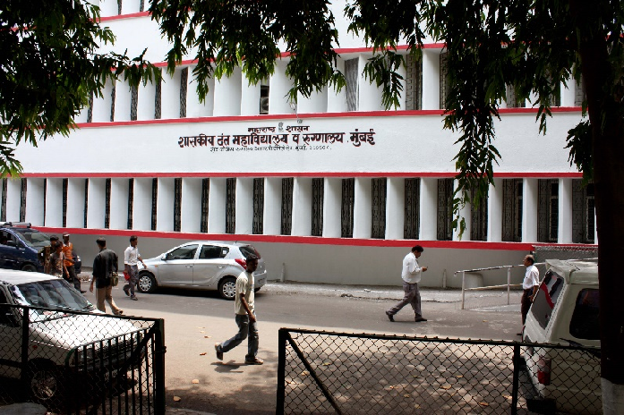
THANK YOU
deangdch_Mumbai@yahoo.com
http://www.gdchmumbai.org

