Slide 1
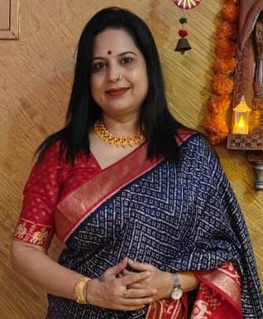
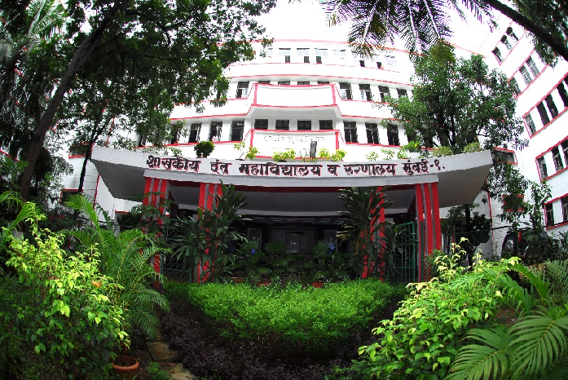
PERSONALITY DEVELOPMENT
GOVERNMENT DENTAL COLLEGE & HOSPITAL, MUMBAI
DEPARTMENT OF PEDIATRIC AND PREVENTIVE DENTISTRY
PRESENTED BY: DR.DIMPLE PADAWE

Slide 2
CONTENT
Introduction
Aspects of personality
Importance of personality development
Time management
Stress management
Relationship management and art of human engineering
Conclusion
Quiz

Slide 3
INTRODUCTION
Personality development is the development from the organized pattern of attitudes and behaviors which makes an individual distinctive.
An individual’s unique pattern of thought ,feelings and behaviors defines his/her identity in society.
It is the way to success.

Slide 4
CORE ASPECTS OF PERSONALITY DEVELOPMENT
Communication skills
Self awareness
Confidence building
Emotional intelligence

Slide 5
IMPORTANCE OF PERSONALITY DEVELOPMENT
Ensures excellence in one’s chosen field.
Contributes to individual and national development.
Increases your chances for success in any undertakings.
To groom and polish your character.
To boost self confidence and enhance self-worth.

Slide 6
MANAGING YOURSELF
Self Knowledge is the beginning of self improvement.
Take your problems as your projects, it will give you strength.
You are the only one who can use your ability.
Nobody can insult you without your permission.

Slide 7
TIME MANAGEMENT
Without Time Management, nothing is possible, with Time Management all things are possible.
Time is the most precious possession of the human race. Time does not wait for any body whosoever is a person either a manager or a worker. One who kills time, kills his and his company’s progresses.
Do things before they become important. Do important things before they become urgent. Do urgent things before they become emergencies. Urgency addiction is a self destructive behaviors.

Slide 8
STRESS MANAGEMENT
Manage the prevailing situations and stress stands eradicated.
Stress leads to confusion, conflict, annoyance, irritation and strain.
Stress is more at present as compared to past due to urbanization, industrialization, mechanization.
Luxuries has become necessities, People have overstuffed their lives.
Organizational stress due to role conflict, role ambiguity, over burdened role, feeling of inequality, lack of soft and professional leadership and absence of group cohesiveness in family friends and professional circle.

Slide 9
RELATIONSHIP MANAGEMENT & HUMAN ENGINEERING
All of us should know how to manage human beings who has to manage the organizations.
Take care of worries of the people working for you and they will take care of your organizational problems.
Understanding and kind behaviour never go waste it is going to pay you sooner or later. Loose any thing but never loose good people.

Slide 10
Your Life is full of Situations & Struggles
Situations That you Cannot Manage become Problems
This Creates Negative Feelings in Your Mind Leading to Fear
This Mild Fear in Subconscious Mind Becomes Worry
Worry Builds Up Pressure In your Mind & Body That Is Stress
Effect of stress on Body is called Strain
And on your Mind is called Tension

Slide 11
SUCCESS IS NOT SPONTANEOUS COMBUSTION BUT YOU HAVE TO FIRST PUT YOURSELF ON ‘FIRE’.

Slide 12
CONCLUSION
We are responsible for what we are, and whatever we wish ourselves to be, we have the power to make ourselves. If what we are now has been the result of our past actions, It certainly follows that whatever we wish to be in future can be produced by our present actions; so we have to know how to act.

Slide 13
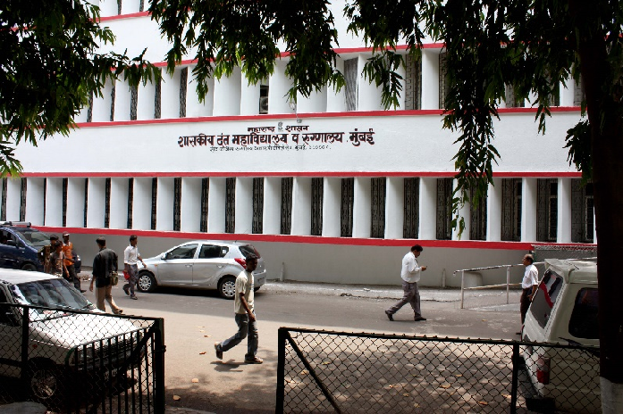
THANK YOU
deangdch_Mumbai@yahoo.com
http://www.gdchmumbai.org

