Slide 1
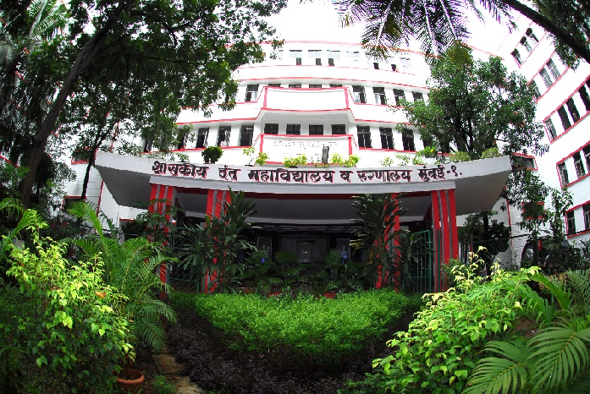
BEHAVIOR MODIFICATION TECHNIQUES
GOVERNMENT DENTAL COLLEGE & HOSPITAL, MUMBAI
DEPARTMENT OF PEDIATRIC AND PREVENTIVE DENTISTRY
PRESENTED BY: DR.BABITHA BABU

Slide 2
CONTENTS
Introduction
Root causes of behavior differences
Theories of behavior modification
Behavior modification techniques
Conclusion
Quiz

Slide 3
INTRODUCTION
Behavior is any activity that can be observed, recorded and measured. It is an observable act or any change in the functioning of an organism
Behavior modification is defined as the attempt to alter human behavior and emotion in a beneficial manner and in accordance with the laws of learning (Eysenck-1964)

Slide 4
ROOT CAUSES OF BEHAVIOUR DIFFERENCES
Individual differences.
Difference in family pattern.
Impairment/disabilities.
Environmental factors
Psychological factors

Slide 5
THEORIES OF BEHAVIOR MODIFICATION
There are mainly 2 theories which are related to behavior modification.
1.Classical conditioning
2.Operant conditioning

Slide 6
BEHAVIOR MODIFICATION TECHNIQUE
Desensitization
It is accomplished by teaching the child a competing response such as relaxation and then introducing progressively more threatening stimuli.
It is an effective method for reducing a maladaptive behavior
Popularly used method for behavior modification by desensitization is Tell-Show-Do technique.

Slide 7
Modeling
Introduced by Bandura, developed from social-learning principle, procedure involves allowing a patient to observe one or more individual (models) who
demonstrate a positive behavior in a particular situation.
Modeling can be done by:
1.Live models
2.Filmed model
3.Audiovisual aids

Slide 8
Contingency management
It is a method of modifying the behavior of children by presentation or withdrawal of reinforcers. These can be
1.Positive reinforcer
2.Negetive reinforcer

Slide 9
CHARACTERISTICS OF BEHAVIOR MODIFICATION
Emphasized defining and measuring behavior.
Treatment focuses greatly on the environment.
Most techniques are based on research on learning.
Emphasizes scientific method
Accountability is placed on everyone involved.

Slide 10
IMPACTS OF BEHAVIOR MODIFICATION
Improved behavioral outcome.
Increased self-awareness.
Enhanced learning and skill development.
Support for mental health.
Organizational benefits.

Slide 11
APPLICATION OF BEHAVIOR MODIFICATION
Parenting and child development.
Education.
Mental health therapy.
Enhancing employee performance and productivity.
Encouraging healthy behavior like exercise, smoking cessation.

Slide 12
CONCLUSION
Behavior modification is a psychological approach , it is commonly used to encourage desired behavior and reduce or eliminate unwanted ones.
Behavior modification is effective because it focuses on observable actions and uses evidence-based methods to achieve specific outcomes

Slide 13
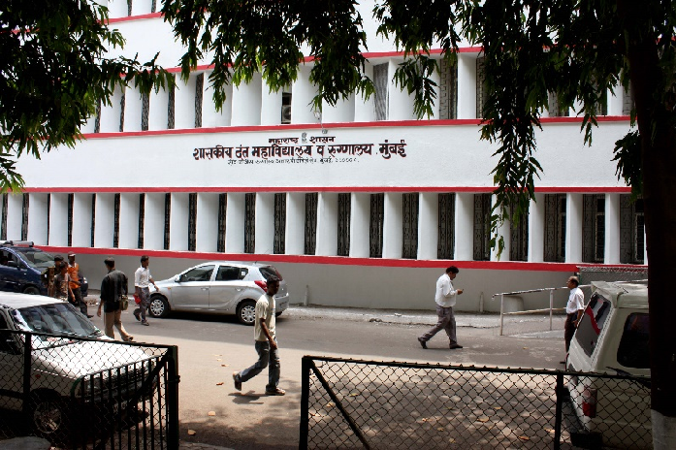
THANK YOU
deangdch_Mumbai@yahoo.com
http://www.gdchmumbai.org

