Slide 1
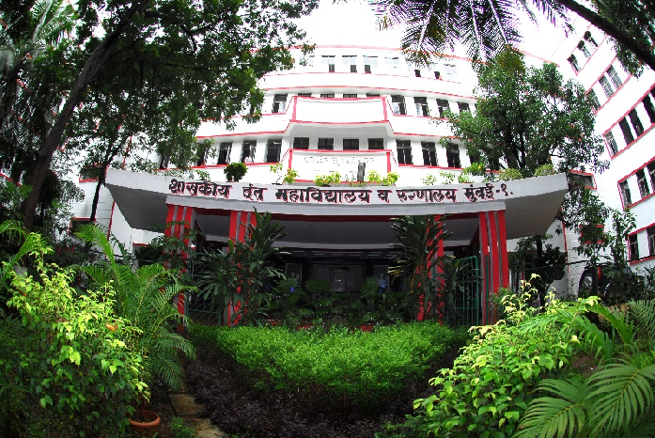
CONTINUING EDUCATION IN DENTAL PROFESSION
GOVERNMENT DENTAL COLLEGE & HOSPITAL, MUMBAI
DEPARTMENT OF PEDIATRIC AND PREVENTIVE DENTISTRY
PRESENTED BY: DR. POOJA RASAL

Slide 2
CONTENTS
Introduction
Definition
Aims & Objectives
Types of CDE programs
Credits required for renewal by the Dental Council of India
Benefits and significance
Conclusion
Quiz
Government Dental College & Hospital, Mumbai

Slide 3
INTRODUCTION
Continuous Dental Education (CDE) in India is regulated by the Dental Council of India (DCI).
It ensures the continuous professional development of dental professionals and improve patient care.
The goal is to keep dental professionals updated with the latest advancements in their field and contribute to global dental education and healthcare standards.
Government Dental College & Hospital, Mumbai

Slide 4
Definition
"CDE" means, any activity in terms of lecture, demonstration, hands-on experience, training dental professional & para-dental staff resulting in imparting, improvement, enhancement, accentuate and advanced knowledge affecting knowledge, skill and attitude of dental professionals for the betterment of patient care and professionalism.
Government Dental College & Hospital, Mumbai

Slide 5
Aim
It aims to include the refinement of existing knowledge and skills, as well as the consideration, appropriate evaluation, and application of new developments and scientific research within the scope of dentistry.
CDE is also aims to provide a more public- and patient-focused approach to prevent oral diseases, rather than solely treating existing disease.
Government Dental College & Hospital, Mumbai

Slide 6
Objectives
The core objective of the CDE is to enhance the skill and attitude of dentists for the betterment of patient care and professionalism thus it should preferably be held in academic environment, convenient to the participants in terms of timings, fee etc.
To incorporate new techniques into practice, improve care in line with current professional standards, and serve the public.
Government Dental College & Hospital, Mumbai

Slide 7
Types of CDE programs in India
Lectures - Lectures should be in some presentation software via PowerPoint, Keynote, OHP, etc.
Lecture cum demonstration - Demonstration should be on typodont teeth or extract teeth
Live demonstration on patients - will be only done by registered dental surgeons *
Simulation training (with lecture)
Video conferencing
Webinar
Video Lectures with moderator
Any hands-on activity for skill enhancement
Government Dental College & Hospital, Mumbai

Slide 8
Credits required for renewal by the Dental Council of India
To ensure the continuous professional development of dentists, the DCI has implemented a point system for CDE. Dentists are required to accumulate ‌ 100 credit points within a five-year period, with a minimum of 20 and a maximum of 25 credit points per year. Failure to comply with this requirement would violate the provisions outlined in the ‘Revised Dentists (Code of Ethics) Regulations, 2014.
Government Dental College & Hospital, Mumbai

Slide 9
Each and every dentist shall have to secure a total of 100 credit points within a period of every 5 years, provided a minimum of 20 credit points and a maximum of 25 credit points per annum.
Out of the 100 credit points in five years, twenty credit points shall be earmarked for the following mandatory topics (five credit points for each topic): (i) Asepsis, infection control and waste management including NACO protocols. (ii) Dental jurisprudence & Ethics, (iii)CPR and basic life support. (iv) Dental Practice Management
Government Dental College & Hospital, Mumbai

Slide 10
A grace period of one year may be awarded to a dentist, who has secured at least 75 CDE points in the allotted time of 5 years, for securing requisite mandatory 100 CDE points, if he/she could not obtain the same within stipulated time period, due to any reason. However, obtaining less than 75 CDE points by a dentist in any 5 years block will be considered as an unethical act and will be considered accordingly.
Government Dental College & Hospital, Mumbai

Slide 11
Benefits and significance
To Dental Professionals
To Employers
To Departments within an Organization, Organizations and Businesses
To the Community, City, State & Nation
Government Dental College & Hospital, Mumbai

Slide 12
Conclusion
Continuing Dental Education Programs are designed to provide training beyond the level of pre-doctoral education in oral health care, using applied basic and behavioral sciences.
The programs help to expand the scope and depth of dental professional knowledge and skills to enable them to provide comprehensive oral health care to a wide range of population groups.
Government Dental College & Hospital, Mumbai

Slide 13
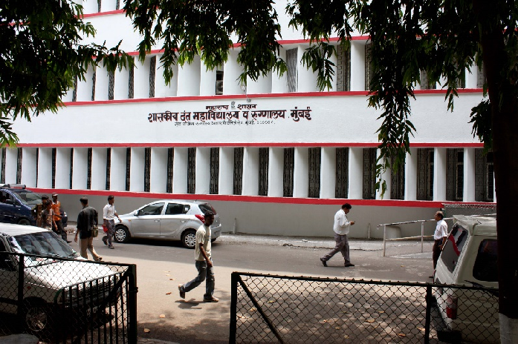
THANK YOU
deangdch_Mumbai@yahoo.com
http://www.gdchmumbai.org

