Slide 1
VERBAL COMMUNICATION SKILLS
GOVERNMENT DENTAL COLLEGE & HOSPITAL, MUMBAI
DEPARTMENT OF PEDIATRIC AND PREVENTIVE DENTISTRY
PRESENTED BY: DR. KOMAL KARNANI

Slide 2
CONTENT
Introduction
Importance of verbal communication
Active listening
Body language & tone of voice
Clarity & conciseness
Adapting to your audience
Handling difficult conversations
Storytelling techniques
Confidence & presence
Conclusion
Quiz

Slide 3
INTRODUCTION
Verbal communication is the foundation of effective interaction, both personally and professionally.
It involves more than just speaking—it includes tone, clarity, and active listening.
Mastering verbal communication enhances understanding, builds relationships, and drives collaboration.

Slide 4
IMPORTANCE OF VERBAL COMMUNICATION
1
Building Relationships
2
Sharing Information
Verbal communication helps us connect with others, build trust, and foster strong relationships.
It allows us to convey ideas, instructions, and knowledge clearly and effectively.
3
Resolving Conflicts
4
Influencing Others
Effective communication skills are essential for resolving conflicts, finding common ground, and reaching mutually beneficial outcomes.
Using persuasive language and clear arguments helps us influence others' perspectives and inspire action.

Slide 5
ACTIVE LISTENING
Focus and Attention
Understanding
Pay full attention to the speaker, making eye contact and minimizing distractions.
Try to grasp the speaker's meaning, both the words and the underlying emotions.
Empathy and Response
Show understanding through verbal cues, body language, and thoughtful responses.
Notes:
Active listening is a communication skill that involves fully concentrating on, understanding, responding to, and remembering what someone else is saying. It goes beyond simply hearing words and focuses on truly engaging with the speaker. This skill is essential in building trust, improving relationships, and resolving conflicts effectively.

Slide 6
BODY LANGUAGE AND TONE OF VOICE
Body Language
Tone of Voice
Maintain open posture, make eye contact, use gestures to emphasize points.
Speak with enthusiasm, vary pitch and volume, use pauses for emphasis.

Slide 7
CLARITY AND CONCISENESS
Use simple language and avoid jargon.
Organize your thoughts logically.
Focus on delivering key messages.
Use short sentences and clear structure.

Slide 8
ADAPTING TO YOUR AUDIENCE
Understanding
Adjusting
Consider their knowledge, interests, and
perspectives.
Use language they understand,
adapt your tone and style.
Engaging
Encourage questions, seek feedback, and respond appropriately.

Slide 9
HANDLING DIFFICULT CONVERSATIONS
Find Common Ground
1
Remain Calm
3
Look for areas of agreement and focus on solutions.
Control your emotions and avoid getting defensive.
4
Respectful Communication
2
Active Listening
Express yourself clearly and respectfully, even when disagreeing.
Focus on understanding the other person's perspective.

Slide 10
STORYTELLING TECHNIQUES
Engage Emotionally
Structure and Flow
Connect with the audience by using vivid language and personal anecdotes.
Organize your story with a clear beginning, middle, and end.
Visualize and Describe
Use imagery and sensory details to paint a picture in the
listener's mind.

Slide 11
CONFIDENCE AND PRESENCE
Positive Body Language
Passionate Delivery
Maintain good posture, make eye contact, and use gestures to convey confidence.
Speak with enthusiasm and conviction, showing your belief in what you are saying.

Slide 12
CONCLUSION
Effective verbal communication is a powerful tool that can transform the way we connect, collaborate, and succeed.
Clear, confident, and thoughtful communication fosters understanding and trust.
By refining our tone, choosing the right words, and actively listening, we can make every interaction meaningful.
Remember, communication is a skill that improves with practice—apply the techniques discussed today in your daily conversations.

Slide 13
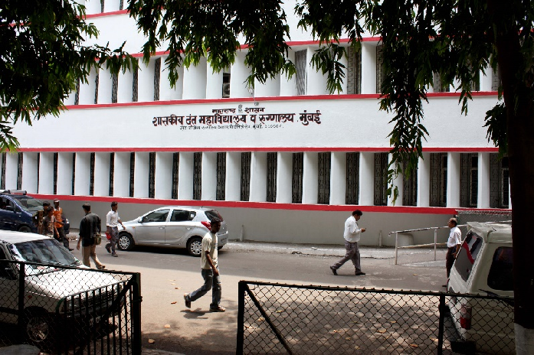
THANK YOU
deangdch_Mumbai@yahoo.com
http://www.gdchmumbai.org

