Slide 1
NON-VERBAL COMMUNICATION
GOVERNMENT DENTAL COLLEGE & HOSPITAL, MUMBAI
DEPARTMENT OF PEDIATRIC AND PREVENTIVE DENTISTRY
PRESENTED BY: DR. KOMMINENI DIVYA SREE

Slide 2
CONTENT
Introduction
Importance of non-verbal communication
Types of non-verbal communication
Non verbal communication in professional setting
Role of building relationships
Practical applications
Conclusion
Quiz

Slide 3
INTRODUCTION
What is Non-Verbal Communication?
Definition: The process of conveying information without the use of spoken or written words.
Key Features:
Universal
Instantaneous
Supports or contradicts verbal communication

Slide 4
IMPORTANCE OF NON-VERBAL COMMUNICATION
Communication
Percentage of Impact:
~55% body language
~38% tone of voice
~7% words (Mehrabian Model)
Builds trust, clarity, and understanding.
Often conveys emotions better than words.

Slide 5
TYPES OF NON-VERBAL COMMUNICATION
Kinesics (Body Language):
Gestures, posture, eye contact, facial expressions
Proxemics (Use of Space):
Personal space, physical closeness
Paralanguage (Vocal Elements):
Tone, pitch, volume, pauses

Slide 6
TYPES OF NON-VERBAL COMMUNICATION
Haptics (Touch):
Handshakes, pats, physical interactions
Appearance:
Clothing, grooming
Chronemics (Time):
Punctuality, response times

Slide 7
NON VERBAL COMMUNICATION IN PROFESSION
Non-Verbal Communication in Professional Settings
Enhances Presentations: Engaging gestures and tone.
Builds Relationships: Trust through open body language.
Aids Conflict Resolution: Calming non-verbal cues.

Slide 8
HOW TO IMPROVE NON-VERBAL COMMUNICATION
Observe: Be aware of others' cues.
Practice: Use open gestures, maintain good posture.
Adapt: Consider cultural differences.
Self-Awareness: Align body language with your words.

Slide 9
ROLE OF IN BUILDING RELATIONSHIPS
Trust:
Open body posture and consistent gestures foster trust.
Empathy:
Mirroring emotions through facial expressions shows understanding.
Credibility:
Steady eye contact and confident gestures enhance your perceived reliability.
Conflict Resolution:
Calming non-verbal cues (e.g., relaxed tone, open gestures) diffuse tension.

Slide 10
COMMON NON-VERBAL COMMUNICATION BARRIERS
Misinterpretation:
Misreading cues due to cultural or individual differences.
Inconsistency:
Body language contradicting spoken words.
Overuse of Non-Verbal:
Excessive gestures or intrusive closeness.
Ignoring Context:
Misjudging the appropriateness of certain cues in specific settings.

Slide 11
PRACTICAL APPLICATIONS
Public Speaking:
Engage the audience with purposeful gestures and vocal variety.
Interviews:
Exhibit confidence through posture, handshake, and eye contact.
Team Collaboration:
Encourage openness and active listening through supportive non-verbal cues.
Healthcare Settings:
Show empathy and reassurance with calming body language.

Slide 12
CONCLUSION
Non-verbal communication complements verbal interaction.
Understand and adapt to cultural and contextual differences.
Practice for personal and professional growth.

Slide 13
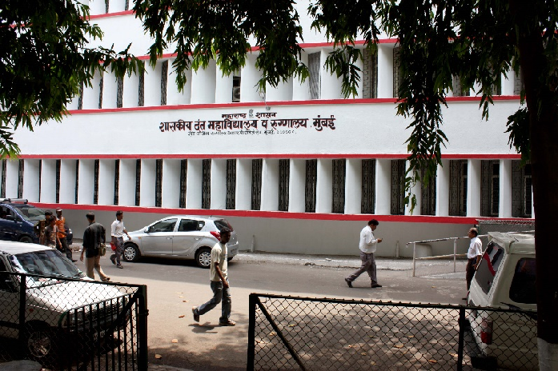
THANK YOU
deangdch_Mumbai@yahoo.com
http://www.gdchmumbai.org

