Slide 1
NEUROLINGUISTIC PROGRAMMING
GOVERNMENT DENTAL COLLEGE & HOSPITAL, MUMBAI
DEPARTMENT OF PEDIATRIC AND PREVENTIVE DENTISTRY
PRESENTED BY: DR. KALYANI BARVE

Slide 2
CONTENT
Introduction
Objectives
Key Principles of NLP
The Meta Model and Milton Model
Conclusion
Quiz

Slide 3
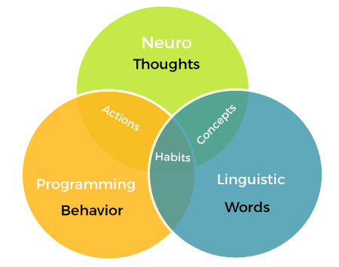
INTRODUCTION
Neuro-Linguistic Programming (NLP) is an approach to communication, personal development, and psychotherapy that focuses on the interplay between neurological processes, language, and learned behavioral patterns.
Developed in the 1970s by Richard Bandler and John Grinder, NLP is designed to help individuals understand and modify their thought patterns and behaviors to achieve personal goals

Slide 4
IMPORTANCE OF COMMUNICATION
Central to relationships, leadership, and teamwork.
Miscommunication can lead to conflicts and inefficiency.
NLP enhances clarity, understanding, and connection.

Slide 5
OBJECTIVES OF NLP
Build stronger rapport with others.
Communicate effectively by understanding language patterns.
Influence and motivate others positively.
Resolve conflicts and misunderstandings.

Slide 6
KEY PRINCIPLES OF NLP
The map is not the territory
Behaviour has a positive intention
Flexibility equals success

Slide 7
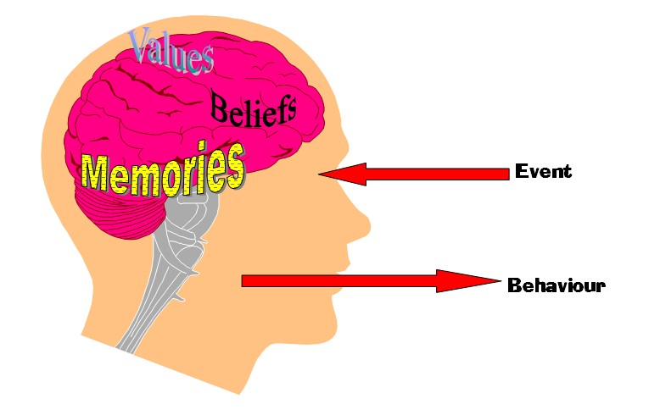
NLP COMMUNICATION MODELS
External events → Internal representation → Emotional state → Behavior.
Filters like beliefs, values, and language shape interpretation.

Slide 8
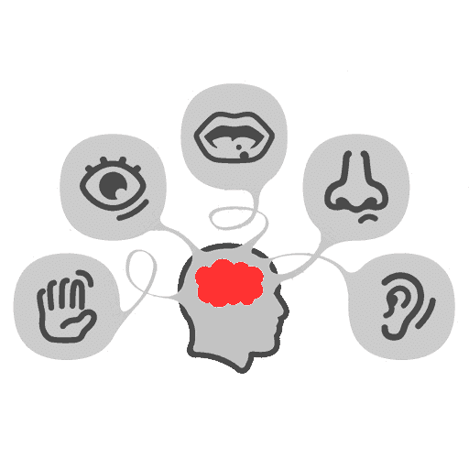
SENSORY PREFERENCES IN NLP
Understanding Representational Systems
Visual: Prefer images, diagrams, and descriptions.
Auditory: Respond to tone, rhythm, and verbal instructions.
Kinesthetic: Relate to touch, feelings, and actions.
Activity: Identifying your dominant system.

Slide 9
THE META MODEL AND MILTON MODEL
Meta-Model
Asking precise questions to clarify communication.
Example: "What do you mean by...?"
Milton Model
Using ambiguity and suggestion for influence.
Example: Storytelling, metaphors.

Slide 10
ANCHORING
Associating a stimulus with a specific emotional state.
Examples: Smiling during positive feedback, using a calm tone in conflict.
How to Anchor: Repetition and consistency.

Slide 11
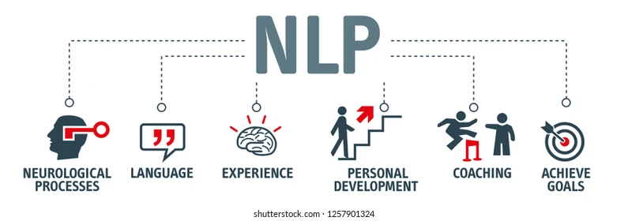
APPLICATIONS OF NLP IN COMMUNICATION
Enhancing personal relationships by improving empathy and connection.
Improving workplace communication, leadership, and teamwork.
Strengthening negotiation and conflict resolution skills.
Building confidence in public speaking or presentations.

Slide 12
CONCLUSION
NLP enhances communication through understanding and techniques.
Practical in personal, professional, and therapeutic settings.
"Effective communication begins with understanding oneself and others."

Slide 13
THANK YOU
deangdch_Mumbai@yahoo.com
http://www.gdchmumbai.org

