Slide 1
EMOTIONAL INTELLIGENCE
GOVERNMENT DENTAL COLLEGE & HOSPITAL, MUMBAI
DEPARTMENT OF PEDIATRIC AND PREVENTIVE DENTISTRY
PRESENTED BY: DR. VILAS TAKATE

Slide 2
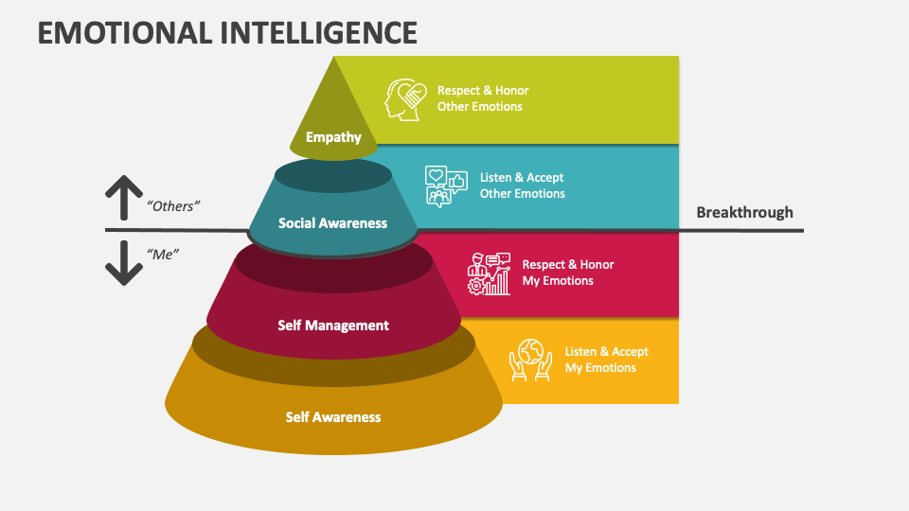
CONTENT
Introduction
Importance of emotional intelligence
Core Components of EI
Self awareness
Self regulation
Empathy in team management
Action steps
Conclusion

Slide 3
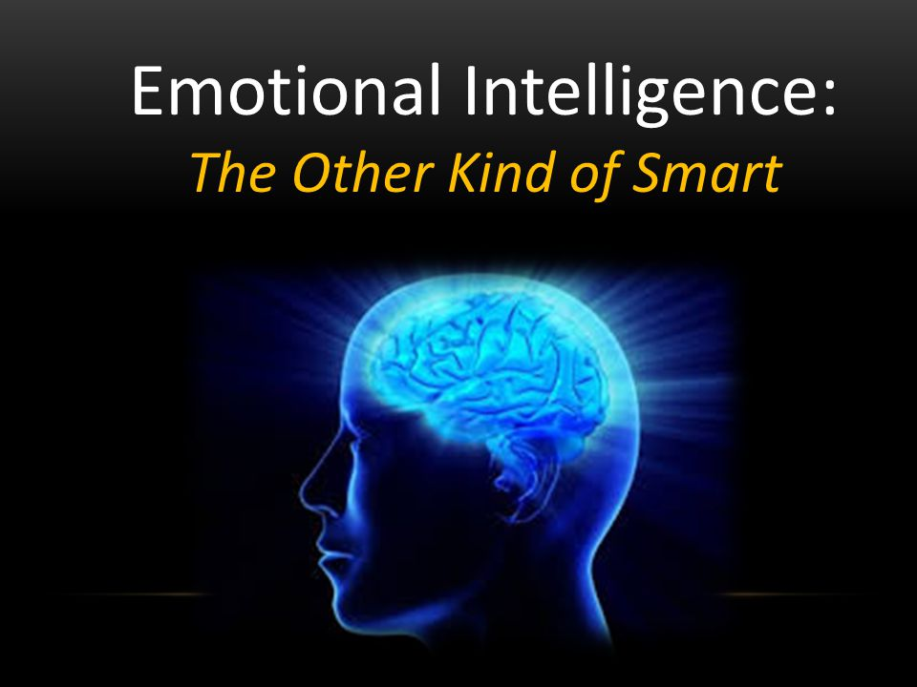
INTRODUCTION
Definition: The capacity to recognize, understand, and manage your emotions and influence others’.
Relevance: EI bridges technical skills and leadership effectiveness in professional environments.

Slide 4
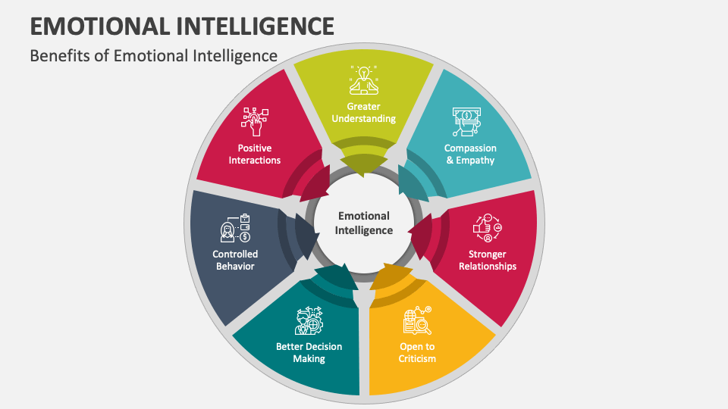
WHY EMOTIONAL INTELLIGENCE MATTERS IN THE WORKPLACE
Improves decision-making under pressure.
Drives team collaboration and morale.
Enhances adaptability in dynamic environments.

Slide 5
THE CORE COMPONENTS OF EI
Self-Awareness: Understanding one’s emotional triggers and patterns.
Self-Regulation: Managing responses to ensure professionalism.
Motivation: A results-oriented attitude with a focus on growth.
Empathy: Fostering understanding of colleagues’ perspectives.
Social Skills: Building rapport and managing conflicts effectively.

Slide 6
SELF-AWARENESS IN ACTION
Recognize stress signals before they escalate.
Conduct periodic feedback assessments.
Align personal strengths with organizational goals.

Slide 7
SELF-REGULATION IN LEADERSHIP
Control impulses in challenging situations.
Exhibit consistency and composure under pressure.
Encourage a calm, problem-solving workplace culture.

Slide 8
EMPATHY IN TEAM MANAGEMENT
Understand and address employee concerns.
Build diverse, inclusive environments.
Use empathy as a tool for employee retention and satisfaction.

Slide 9
ENHANCING SOCIAL SKILLS
Networking: Build strategic professional relationships.
Communication: Deliver feedback with clarity and respect.
Conflict Resolution: Mediate disputes with a win-win approach.

Slide 10
PROFESSIONAL BENEFITS OF HIGH EI
Leadership: EI is a hallmark of inspiring and effective leaders.
Productivity: Teams led by emotionally intelligent individuals outperform others.
Crisis Management: Navigating uncertainty with resilience and adaptability.

Slide 11
ACTION STEPS
Assess your current EI level through feedback and tools.
Practice mindfulness and active listening daily.
Invest in EI training for professional development.

Slide 12
CONCLUSION
Emotional intelligence can be developed through intentional practice.
It’s essential for workplace effectiveness and career growth.
"Emotional intelligence isn’t a luxury—it’s a necessity for leading a fulfilling and impactful career."

Slide 13
THANK YOU
deangdch_Mumbai@yahoo.com
http://www.gdchmumbai.org

