Slide 1
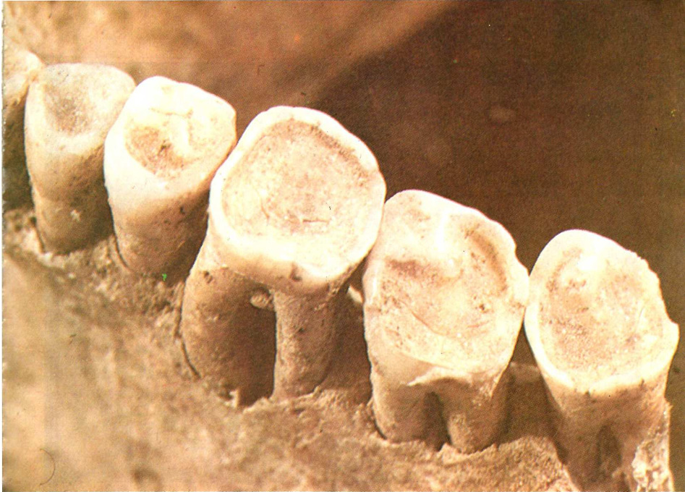

APPLICATIONS OF PELEODONTOLOGY

Slide 2
1. Dental Traits and Environmental Influences:
Observation of general metric and non-metric, individual and class dental traits amongst archaeological remains of ancient populations provide an insight with respect to their prevalence and geographical variations.
Metric analysis of teeth can be linked to general trends of growth in a population
Certain non-metric traits can be frequently noted within populations in different geographical areas.

Slide 3
An example of such a trait would be presence of 'Shovel-shaped incisors' which is a hereditary dental trait commonly noted in populations of Asian or Native American origin.
Additionally, significant prevalence degree of hypoplasia or fluorosis could aid in identification of genetic and environmental influences on dentition of ancient populations.
Other definitive non-metric traits include Cusp of Carabelli, wrinkled molars, cusp seven, accessory ridges in canines, to name a few.

Slide 4
2. Behavioral and Cultural practices:
One of the chief implications of Paleodontology is correlation of dental modifications with behavioral and cultural practices of an ancient population.
Dental modification can be described as intentional or unintentional modification of teeth caused by pathologies, traumatic or cultural factors.
Teeth get modified for various purposes other than wear from mastication and attrition such as regularly holding objects between them, decoration or intentional modifications for aesthetic or cultural purposes.

Slide 5
Some examples of such practices include: V-shaped mutilation of maxillary incisors in ancient Turkish population, filing of teeth with modification exhibiting 'T' pattern in males and 'diamond’ pattern in females in adults of Indonesian royal families.
These modifications could have a ritualistic value for the population, for example, deeming an individual of a suitable age for marriage or hunting.
Likewise, in animal dentitions, long and sharp canines have been associated with aggressive social behavior and competition amongst males.
This is demonstrable in ancient male primates, camels and wild boars exhibiting sharp and prominent cuspids suggestive of aggressive social behavior and male-to-male competition.

Slide 6
3. Oral Hygiene Status
The number of teeth with carious involvement, alveolar bone levels, missing teeth, fenestrations, dehiscence and other related findings elucidate oral health status of the ancient populations in general.
Attrition of occlusal surface is usually evident in teeth recovered from archaeological sites, the severity of which is greater than modern-day dentitions owing to advent of processed foods.
Presence of sharp cusp tips and incisors in older primates provides further
evidence pertaining to their coarse and raw carnivorous diet.
The relatively coarse and raw diet of ancient populations also ensured regular and sufficient cleansing of surfaces of teeth, subsequently, allowing minimal chance for long-term calculus deposition.
Thus, alveolar bone loss resulting from periodontal diseases could be correlated as a part of evolutionary process.

Slide 7
4. Gender Determination:
Sexual dimorphism in humans has been attributed to the different growth trajectories of males and females.
The condyle and ramus components of the mandible are considered to exhibit greatest morphological differences based on gender.
Previous research has led to significant findings when distinguishing sexes of archaeological specimens based on intra-ramus and inter-ramus dimensions.
Distinct dental modifications for separate sexes carried out as a part of cultural practices further aid in sex determination.
Both the metric as well as non-metric dental traits can be effectively utilized for aiding in gender determination amongst archaeological specimens.
Apart from dental features, the entities that can be correlated with gender extend to include other bones of the skull, particularly the frontal bone.

Slide 8
5. Age Estimation
Dental age estimation has always been an integral part of cases pertaining to forensic odontology.
Teeth are particularly suitable for dental age estimation since they exhibit numerous age-related changes such as fatty degeneration, pulpal atrophy, calcifications, pigment deposits, reduction in size of pulpal cavity, increased cementum thickness, attrition and change in optical properties of the tooth structure.
Determining exact chronological age can be extremely challenging and various modalities have been employed for the same.
These include assessment of suture closures, teeth erupted and shed, amount of attrition and numerous other entities.
The technique that offers the highest probability of accurate age estimation can be rightly deemed as superior and valid in the court of law.

Slide 9
However, many of these methods involve procurement of teeth from the specimens, which is mostly contraindicated in paleodontological specimens.
Non-invasive methods that do not disturb the integrity of the specimens should be considered in such cases.
Over the years, various techniques for age estimation by dental specimens or tissues have been developed, of which the mostly commonly employed are radiographic methods.
Radiographic methods are particularly suitable for paleodontological studies because of their inherent non-destructive nature, feasibility, efficiency and reasonably high degree of accuracy in estimation of age.

Slide 10
6. Recent Advances:
The advent of DNA extraction and amplification techniques have definitely revolutionized the field of Forensic Odontology as a whole and these can be effectively utilized in Paleodontology.
These modalities could provide valuable information about the genetic makeup of ancient population which would have otherwise been considered as impossible a few decades ago.
Modern-day digital impression techniques by means of laser scanners combined with subsequent 3D printing are able to provide precise replication of the archaeological specimens.
Overall, the improved techniques for visualization and reconstruction of
archaeological evidence would definitely enhance the quality of paleodontological research.

Slide 11
THANK YOU

