Slide 1
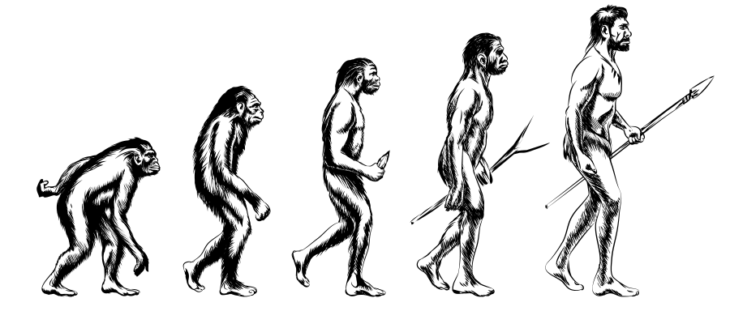
COMPARATIVE STOMATOLOGY OF ANCIENT & MODERN ERA

Slide 2
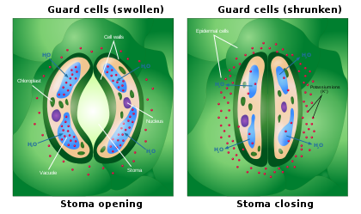
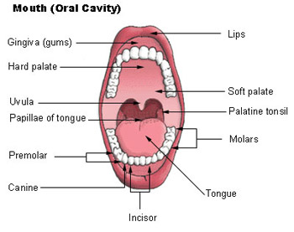
Stoma –
In botany - pore found in the epidermis of leaves, stems, and other organs, that controls the rate of gas exchange.
In Medicine - mouth
Logy – study
Stomatology – the branch of medicine concerned with the study of structures, functions and diseases of mouth.

Slide 3
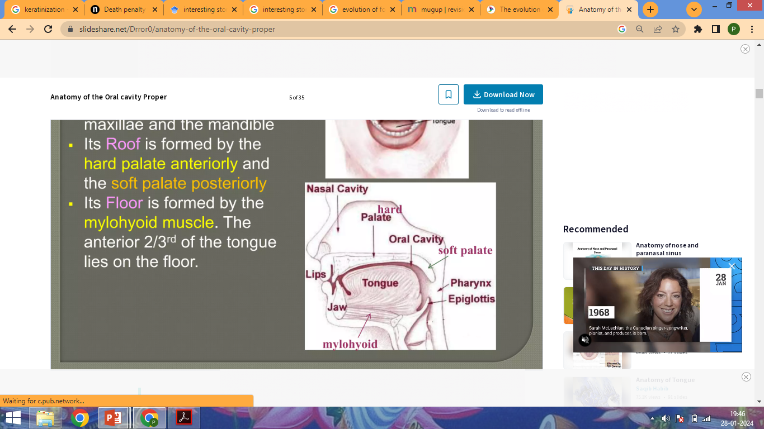
ORAL CAVITY
It’s a cavity within alveolar parts of maxilla & mandible
Roof -> ant = hard palate
post = soft palate
Floor -> mylohyoid muscle
Tongue – 3 parts
Anterior 2/3rd
Posterior 1/3rd
Root

Slide 4
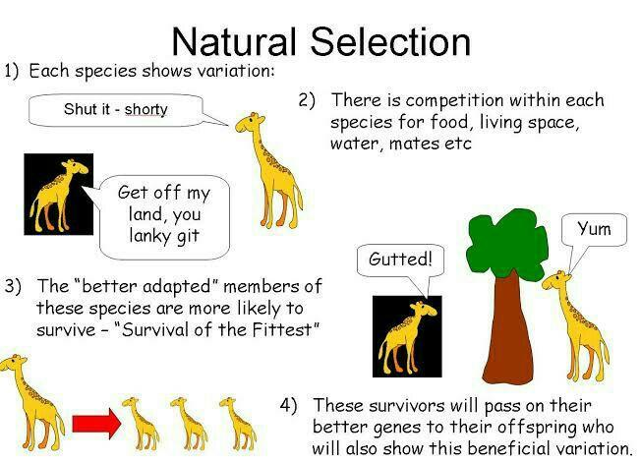
EVOLUTION -
Evolution suggests that a large variety of plant and animal life existed on earth, which have gradually developed through natural processes.
Charles Darwin –
Theory Of Natural Selection

Slide 5
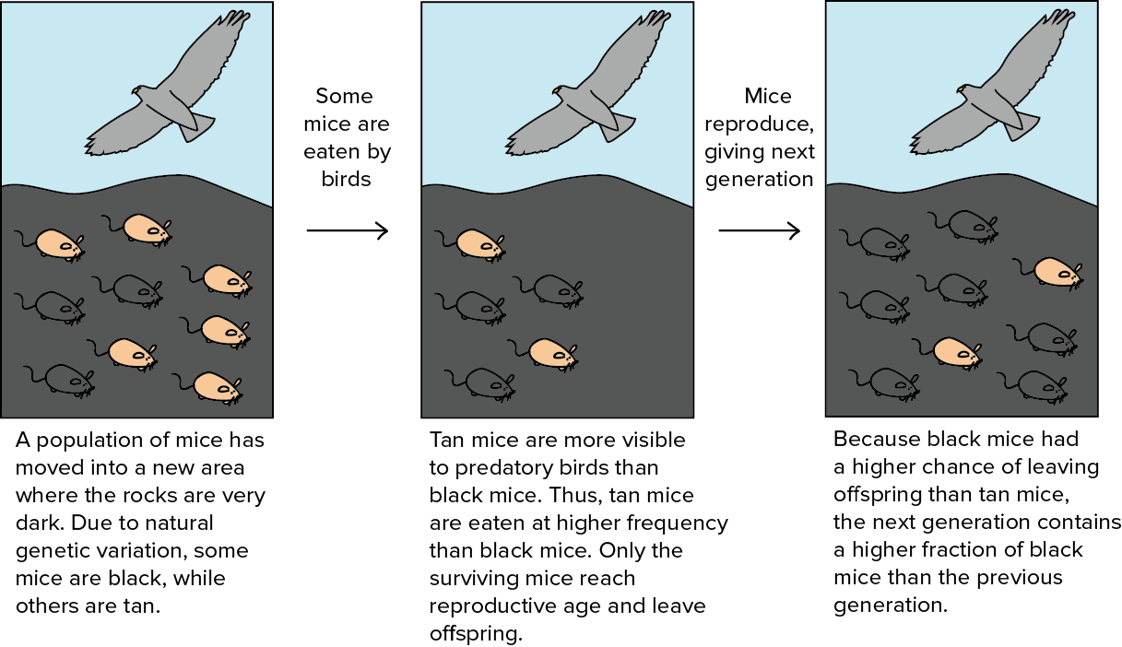

Slide 6
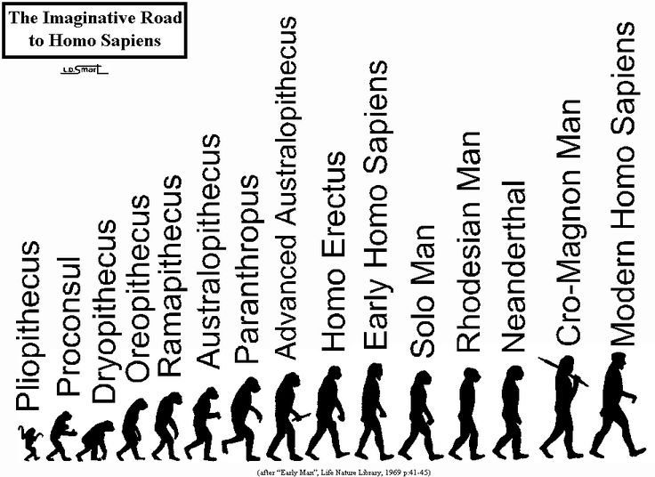
HUMAN EVOLUTION

Slide 7
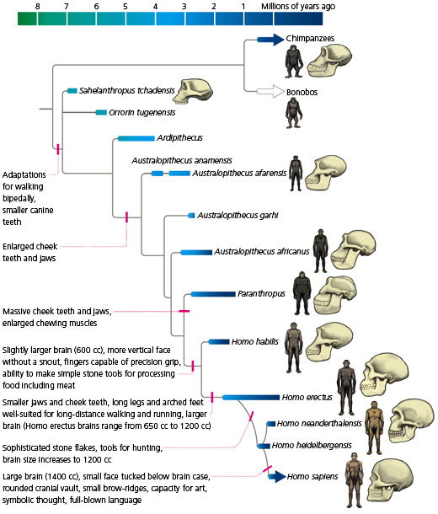

Slide 8
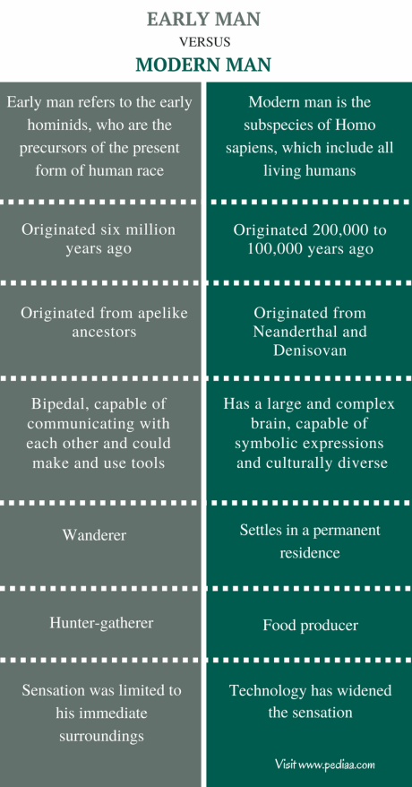
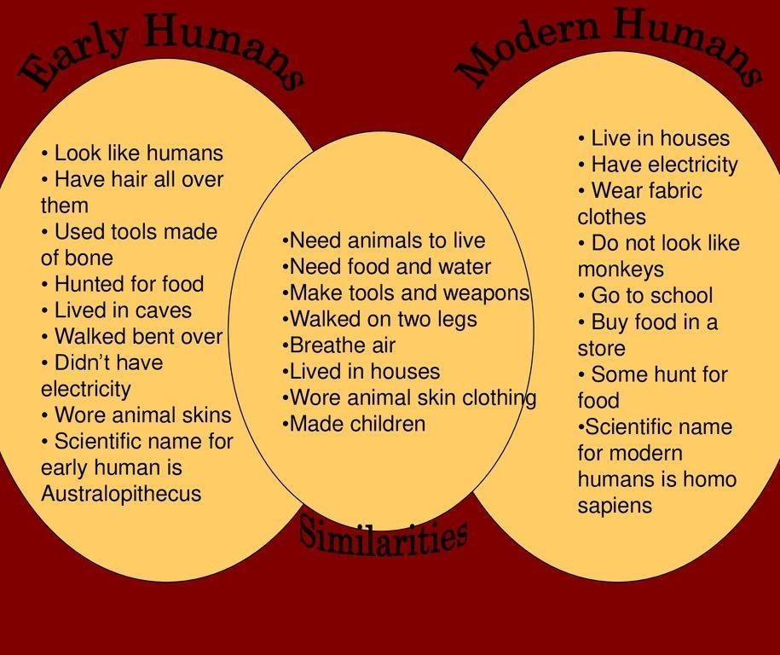
Ancient man and Modern man
Early Man Modern Man

Slide 9
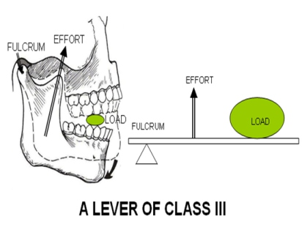
NUTRITION & HUMAN EVOLUTION
Gathering and hunting have been the basis of nutrition. It was not until about 12,000 years ago that humans began domesticating plants and animals.
Homo sapiens- Ultra-processed food means pleasure gain and further increased consumption.
During function, masticatory forces are transmitted throughout the TMJ to the cranial base, is essential for the growth, development, and remodeling of TMJ.

Slide 10
TEMPOROMANDIBULAR JOINT
Components of TMJ-
Articular tubercle
Anterior part of mandibular fossa
Posterior non-articular part formed by the tympanic plate.
Ligaments –
Temporomandibular/ Lateral Ligament
Sphenomandibular ligament

Slide 11
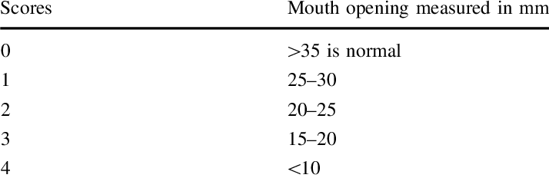
Movements
1 Depression (open mouth)
2 Elevation (closed mouth)
3 Protrusion (protraction of chin)
4 Retrusion (retraction of chin)
5 Lateral or side-to-side movements during chewing or grinding.

Slide 12
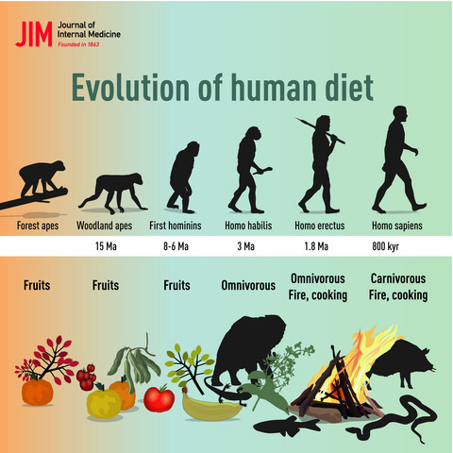

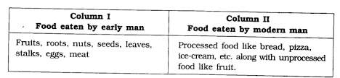

Slide 13
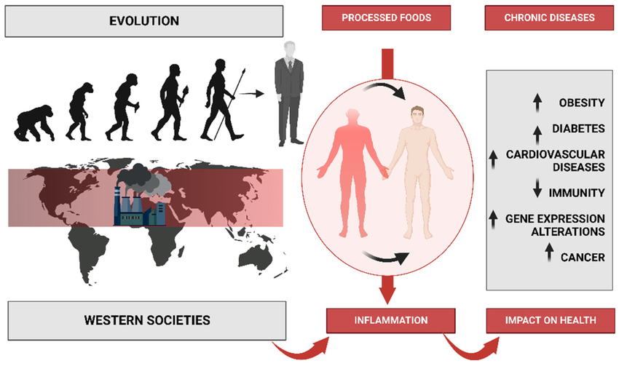

Slide 14
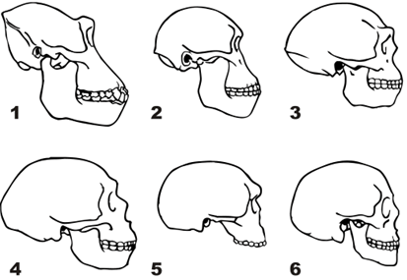
Shorter jaw with smaller teeth - >
7 million
Long jaws
Teeth arranged in rows
5.5 million
Shorter jaws
1.8 million
Shorter jaws
Long pointed canine
Shorter canine
Teeth wider posteriorly than anteriorly
Shorter canine similar to ours
Face is vertical
2 lac -50,000
Shorter jaws
Pointed chin
Parabolic arc
3,500 to present
  Short jaws
  Teeth are wider posteriorly than anteriorly

Slide 15
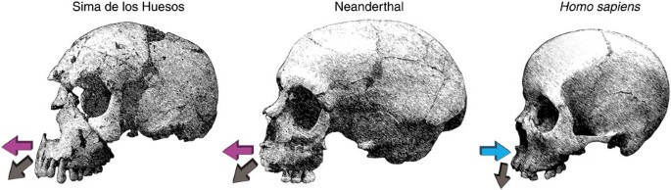
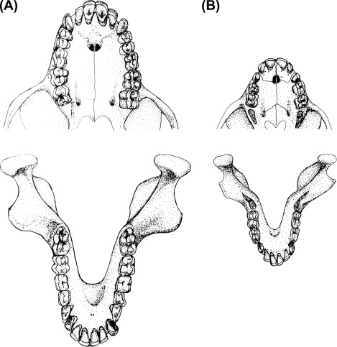
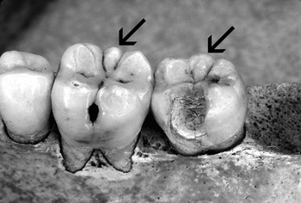
S.No. | DENTAL ARCADE & TOOTH ROWS
 | Early Man | Modern Man
1 | Rectangular/ U shaped arc | Parabolic/ round arc
2 | Gaps present adjacent to canine – Upper jaw- in front of canine Lower jaw- behind canine | No gap
3 | Long jaws -> projecting facial profile | Shorter jaws -> no projecting facial profile
4 | No chin | Pointed chin
5 | Longer incisors | Smaller incisors
6 | Pointed canine Sharper in females than in males | Blunt comparatively Almost similar in males and females
7 | Molars had many cusps- 7 cusped molars | Flatter premolars and molars Wisdom teeth present/impacted / absent
8 | Thin enamel | Thicker enamel
Evolution of maxilla
A – maxilla
B- mandible
7 cusped molar

Slide 16
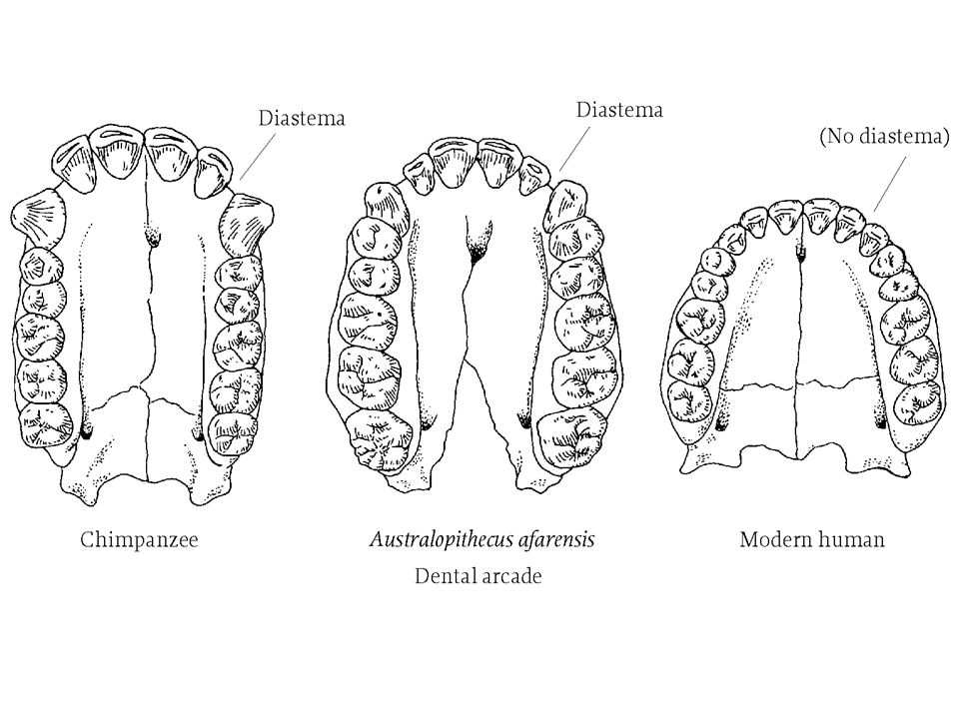
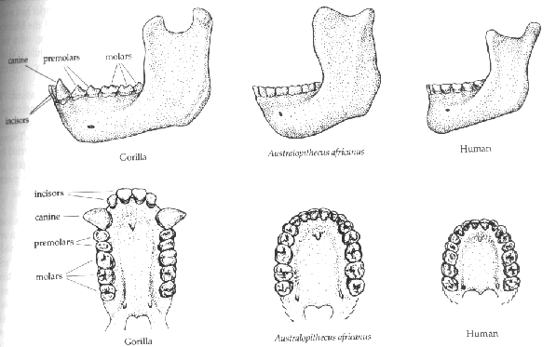
Gorilla
Australopithecus afarensis
Homo sapiens

Slide 17
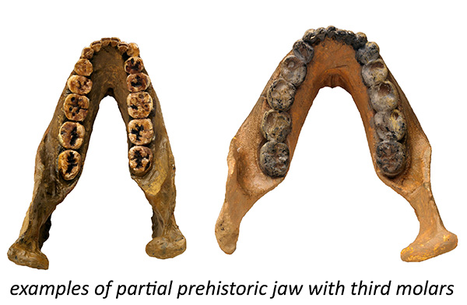
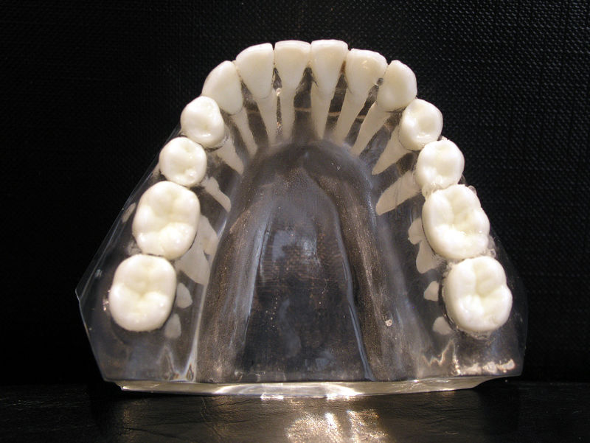
Prehistoric mandible with 3rd molar
3rd molar can be present/ impacted/ absent in homo sapiens

Slide 18
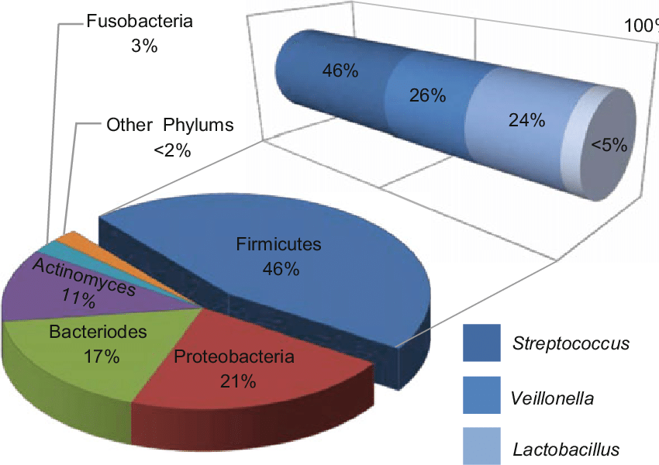
S.No. | MICROBIAL ENVIRONMENT
 | EARLY MAN | MODERN MAN
1. | Actinomyces – most dominant genus | Streptococcus
2 | Fretibacterium – 2nd most dominant | Fusobacterium SR1 & Gracilibacteria GNO2
2 | Eubacterium | Porphyromona gingivalis
3 | Nellicutes | Prevotella pleuritidius
4 | Treponema socranskii
5 | Eggerthella
6 | Periodontitis causing micro- organisms- Actinomyces & Eggerthella | Porphyromona gingivalis Fusobacterium nucleatum

Slide 19
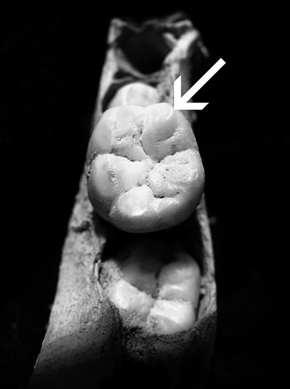
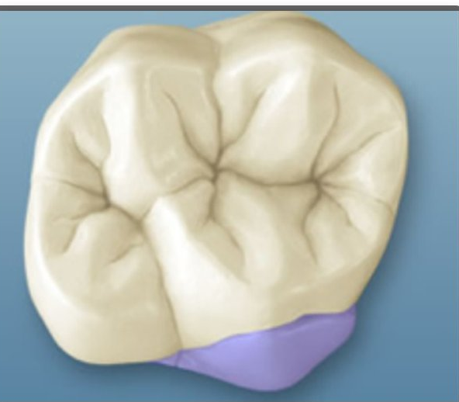
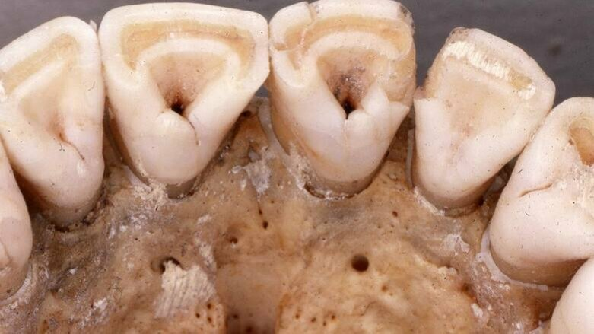
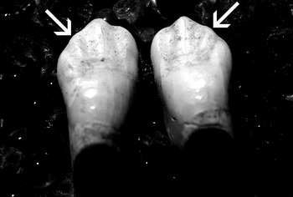
Dental Traits & Environmental Influence
Cusp Of Carabelli
Shovel Shaped Incisor
Wrinkled Molar
Accessory ridges in canines
Seven Cusped Molar

Slide 20
References-
Paleodontology: The relatively unexplored aspect of Forensic Odontology
Phulari RG. Textbook of dental anatomy, physiology and occlusion. JP Medical Ltd; 2013 Nov 30.
Chaurasia BD. Human anatomy. New Delhi, India: CBS Publisher; 2004.
Owtad P, Park JH, Shen G, Potres Z, Darendeliler MA. The biology of TMJ growth modification: a review. Journal of dental research. 2013 Apr
Shorter jaws with smaller teeth: Beth Blaxland, Fran Dorey , 2018
Shiba T, Komatsu K, Sudo T, Sawafuji R, Saso A, Ueda S, Watanabe T, Nemoto T, Kano C, Nagai T, Ohsugi Y. Comparison of periodontal bacteria of Edo and modern periods using novel diagnostic approach for periodontitis with micro-CT. Frontiers in Cellular and Infection Microbiology. 2021 Sep 20
Shiba T, Komatsu K, Sudo T, Sawafuji R, Saso A, Ueda S, Watanabe T, Nemoto T, Kano C, Nagai T, Ohsugi Y. Comparison of periodontal bacteria of Edo and modern periods using novel diagnostic approach for periodontitis with micro-CT. Frontiers in Cellular and Infection Microbiology. 2021 Sep 20;11:723821.

Slide 21


