Slide 1
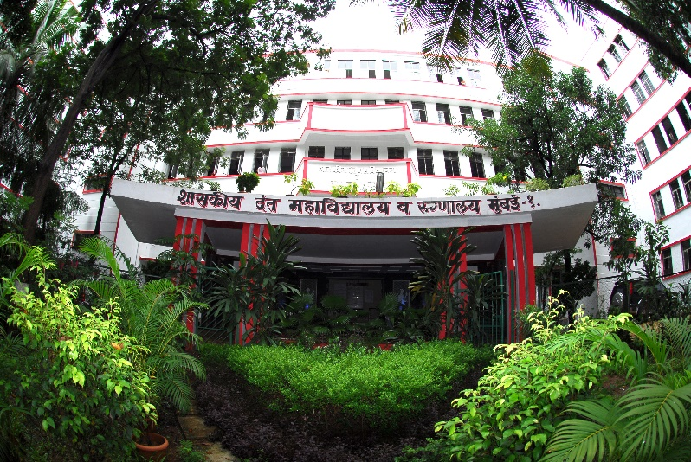


Paleoanthropology - study of pre-historic human and proto-human fossil
GOVERNMENT DENTAL COLLEGE & HOSPITAL, MUMBAI
Dept Logo
PALEODONTOLOGY-DEPARTMENT OF ORAL PATHOLOGY AND MICROBIOLOGY

Slide 2
Learning objectives & Key words
Acquire familiarity with the Geologic Time Scale
Describe how fossils are used to identify subdivision of the geological time scale
Explain how fossils have been used to define and identify subdivisions of the geologic time scale.

Slide 3
FOSSILS
Preserved remains or traces of an organism that lived in the past.
Fossils are formed when animals die and are buried in sediment.
Eventually the sediment builds up and hardens to become sedimentary rock.
Sediments are pieces of solid material that have been deposited on Earth's surface by wind, ice, gravity, or chemical precipitation.
Paleontologist-scientist who study the remains of organisms in the rock record.

Slide 4
INDEX FOSSILS
Remains of plants and animals that lived for a limited period.
Best index fossils are common, widely distributed, and easy to identify.
Some of the most common index fossils are ammonites, trilobites, and graptolites.

Slide 5
TYPES OF FOSSILS
Petrified - when minerals replace the remains and they become rock things like wood.
Mold - when the shell remains and the contents dissolve (hollow) like in art class you use a mold to get the correct shape of a bowl.
Cast- when the mold becomes filled with minerals that are not a part of the original organism.
Index-a fossil found in a narrow time range but widely distributed around the earth; used to date rock layers.
Trace fossil-a fossilized mark that is formed in soft sediment by the movement or actions of an animal.

Slide 6
RELATIVE VS ABSOLUTE DATING
RELATIVE DATING
ABSOLUTE DATING
Relative dating- looks at where the fossil is located to determine its age relative to other fossils.
This only works if the area has been undisturbed.
• Uses radioactive elements near the fossils to determine the actual age of the fossils.
By determining the age of the radioactive element, scientists can calculate the age of the fossil buried nearby.
The absolute age of fossils is estimated by dating associated igneous rock and lava flows

Slide 7
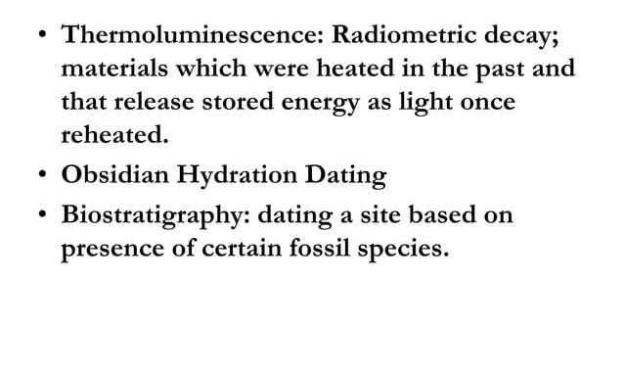
DATING METHODS

Slide 8
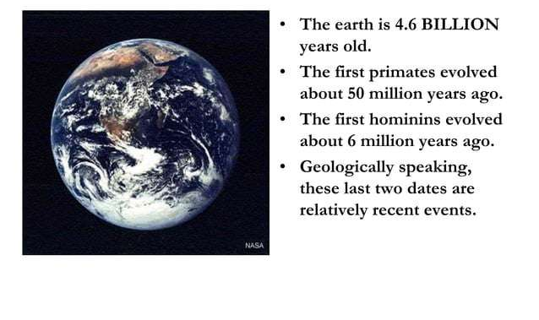
GEOLOGIC TIME

Slide 9
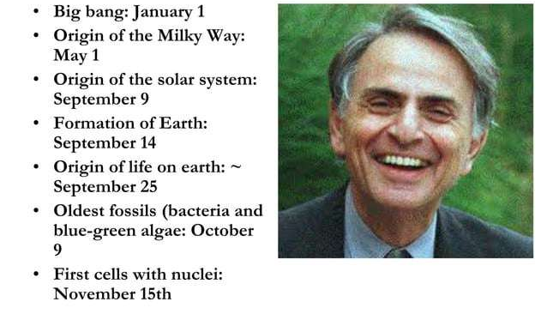
CARL SAGON’S COSMIC CALENDER

Slide 10
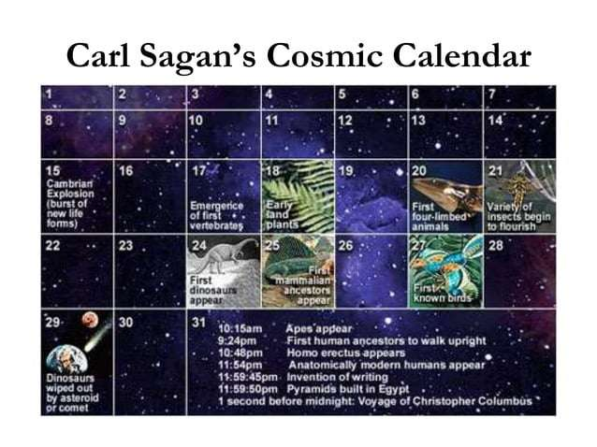

Slide 11
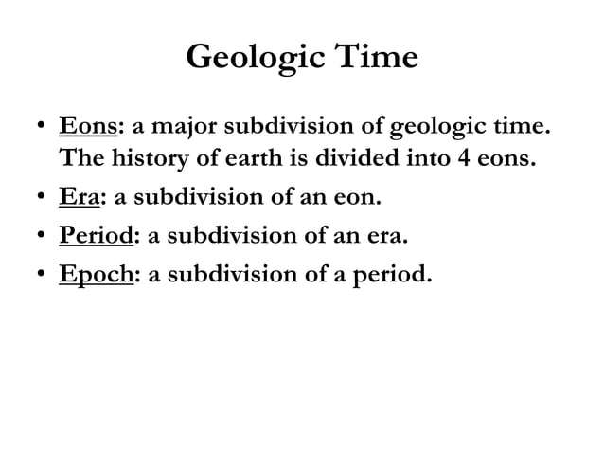
GEOLOGIC TIME

Slide 12
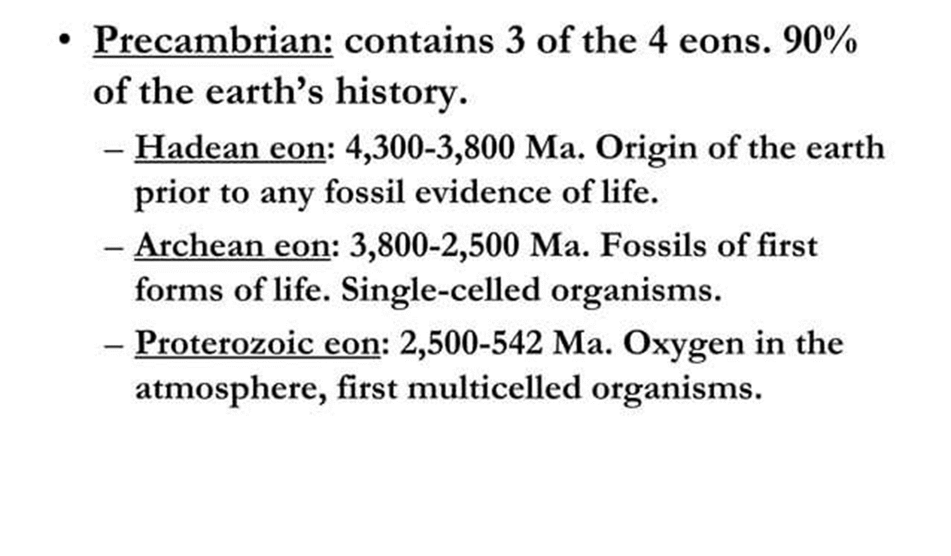
GEOLOGIC TIME

Slide 13
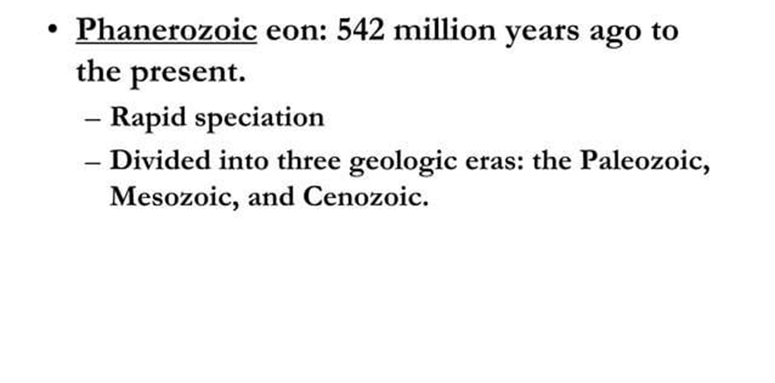
GEOLOGIC TIME

Slide 14
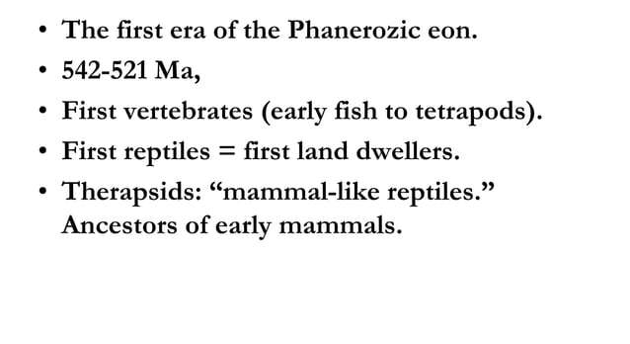
GEOLOGIC TIME:PALEOZOIC ERA

Slide 15
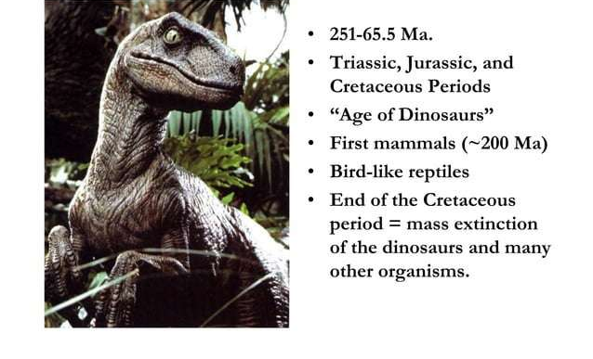
GEOLOGIC TIME:MESOZOIC ERA

Slide 16
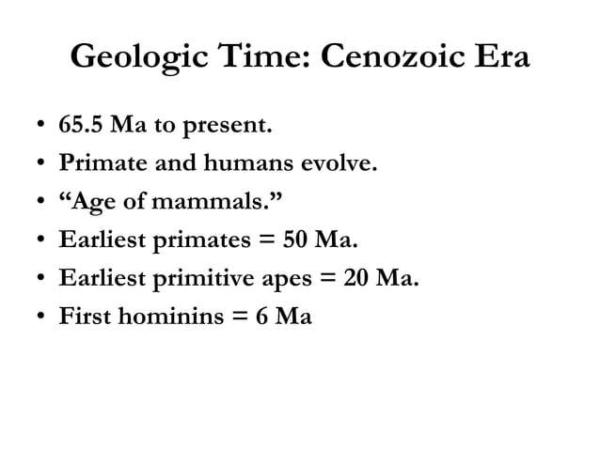
GEOLOGIC TIME:CENOZOIC ERA

Slide 17
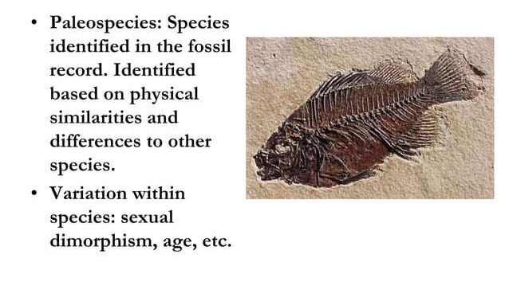

Slide 18
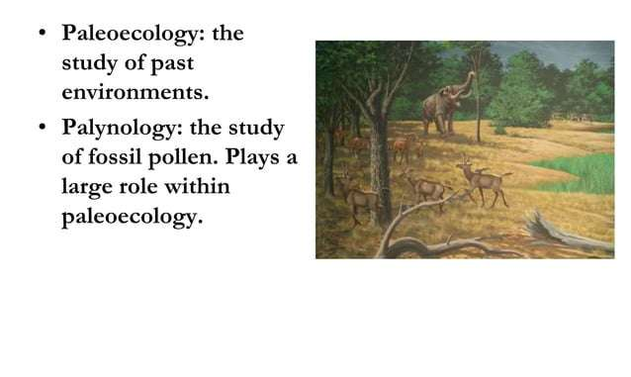
PALEOECOLOGY

Slide 19
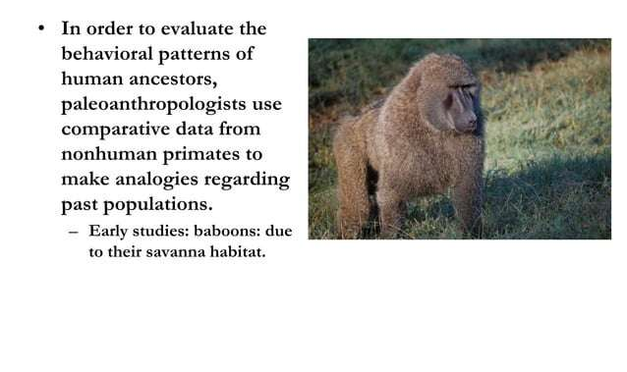
PAST BEHAVIOUR

Slide 20
CONCLUSION
Fossils serve as a key to understanding geological timelines, environmental changes, and the adaptations of ancient species.
Techniques such as relative and absolute dating enhance our ability to accurately position fossils within the geologic time scale.
By integrating paleoecological data and fossil evidence, we can reconstruct past behaviors and environments, bridging the gap between ancient and modern life forms.
This field continues to deepen our understanding of biodiversity and the intricate dynamics of evolution.

